Slide 1


Slide 2
DOK-ING D.O.O. ZAGREB, CROATIA
International Lessons Learned in C-IED/EOD & CBRNe Defense and Response
Extreme Hot Zone
and
Remote Controlled Systems
Speaker: Zvonko Orehovec

Slide 3
Content
Definition of CBRNe Threats Today
Definition extremely hot zone
Remote controlled Vehicles as a response in C-IED/EOD & CBRNe threats

Slide 4
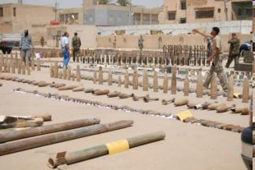
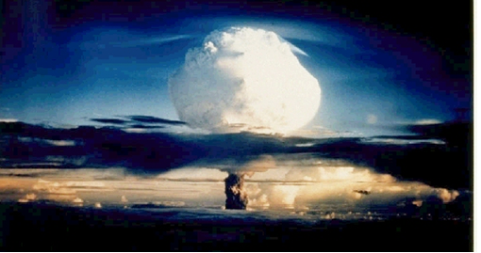
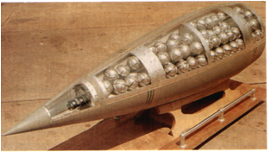
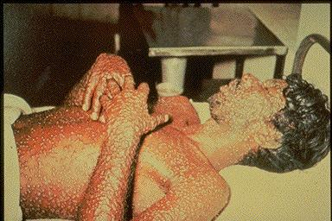
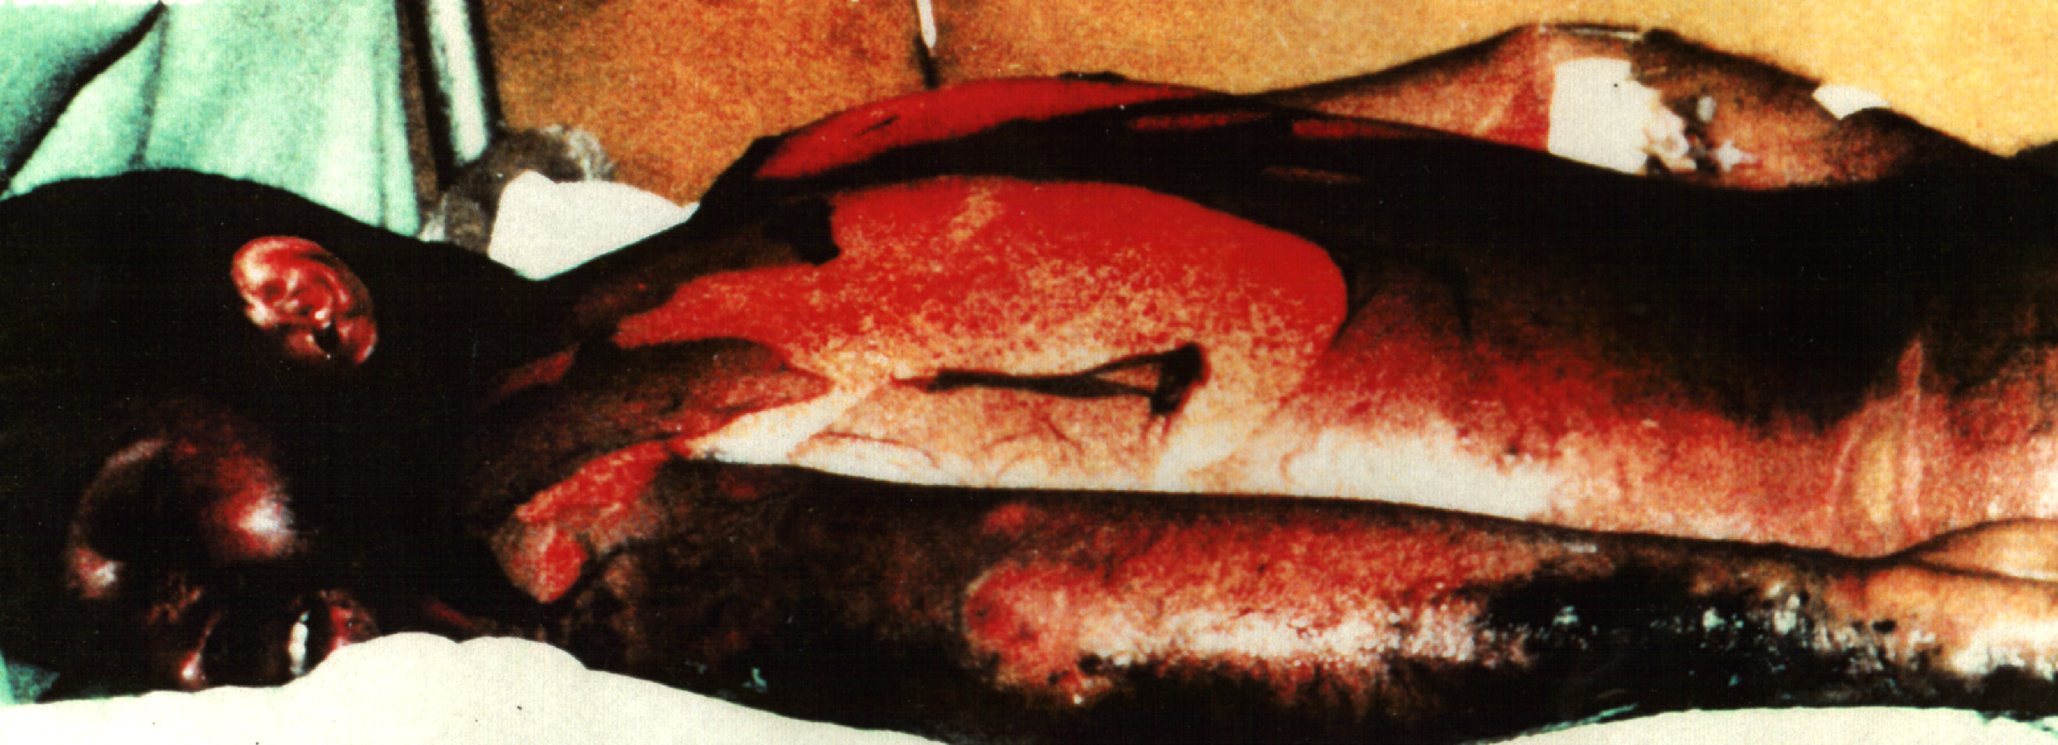
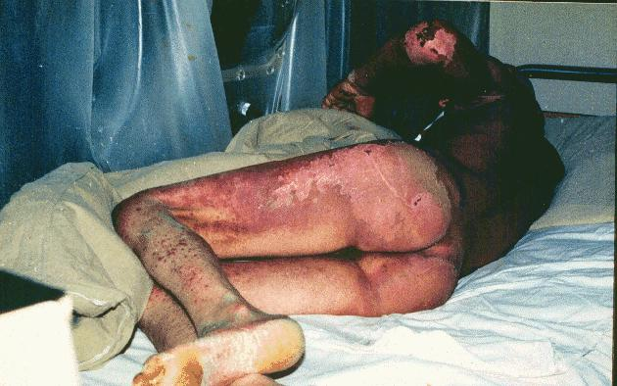
NBC Warefare

Slide 5
Only?
Or and?

Slide 6
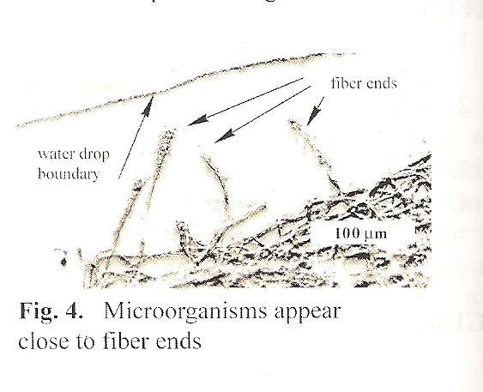
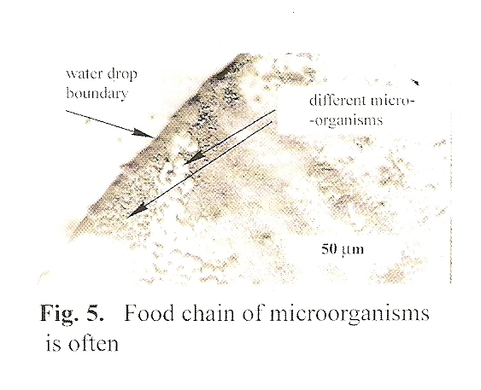
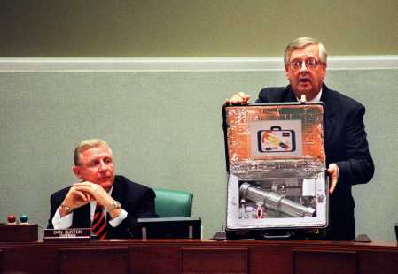
Case Studies – Terroris Actions
Terrorist attack by NRBC weapons, devices or RBTC agents.

Slide 7
Only?
Or and?

Slide 8
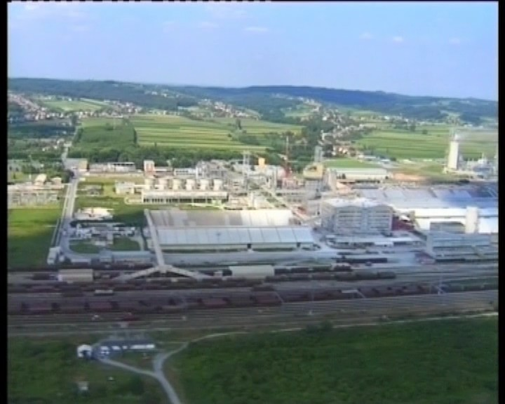
Chemical Industry today
Terrorist and/or military attack on production processes and storages.
10 Production plants
  NPK - 750 000 t
  KAN - 250 000 t
  UREA - 350 000 t
  Amonium – 1 360 t/d
  Sulphur acid – 1 500 t/d
  Phosphorus acid – 550 t/d
  Nitrogen acid – 2 800 t/d
3 Energetic plants
1 350 000 t/y

Slide 9
TIC in production processes
Ammonia
Hydrocarbon gases
Hydrogen
Nitrogen oxides
Sulphur dioxides and trioxides
Chlorine
Sulphur acid
Nitrogen acid
Phosphorus acid
Pesticides
Phosgene, Diphosgene
PCB, PSB, Dioxins
Organic toxic substances…

Slide 10
Storage capacity for row material
Elementary sulphur - 45 000 tons
Phosphate – 90 000 tons
Potassium – 140 000 tons
Dolomite – 50 000 tons
Mineral fertilizer storage
Urea – 100 000 tons
KAN – 45 000 tons
NPK – 180 000 tons
Ammonium nitrate – 2 200 tons

Slide 11
Specifics of catastrophe in chemical, petrochemical, oil... industries
Speed of catastrophe (extreme pressures and temperatures)
Speed of intensities and dispersion of toxic chemicals
Depending of meteorological conditions
No possibility to evacuate without protection equipment
No possibility to remove toxic cloud from factory area

Slide 12
Only?
Or and?

Slide 13
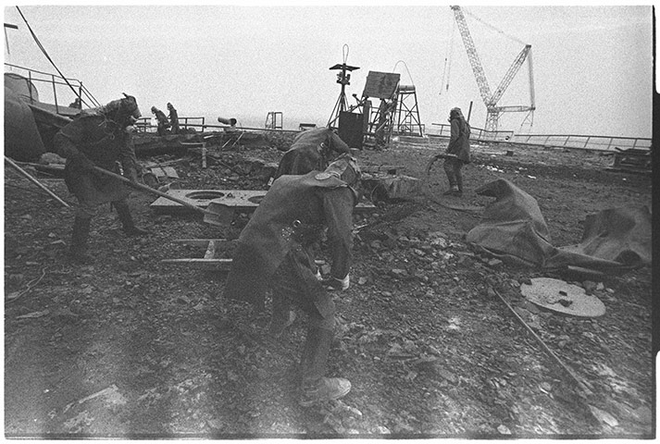
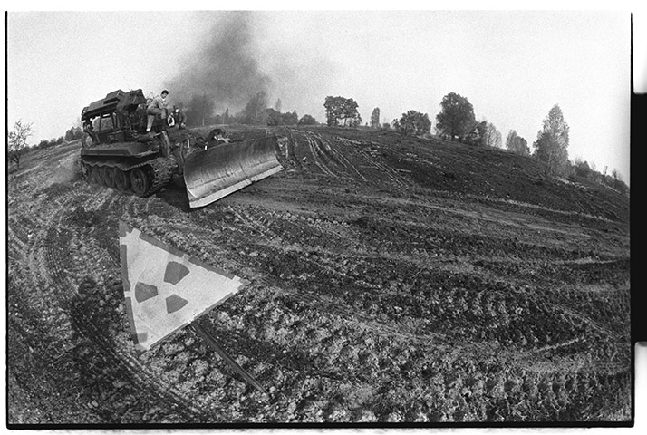
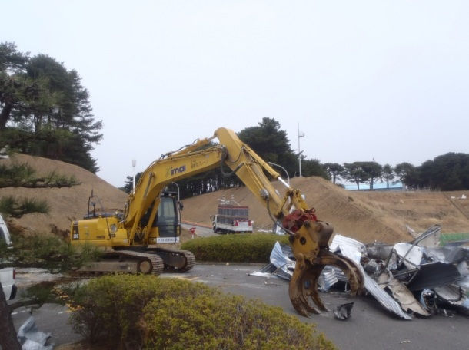
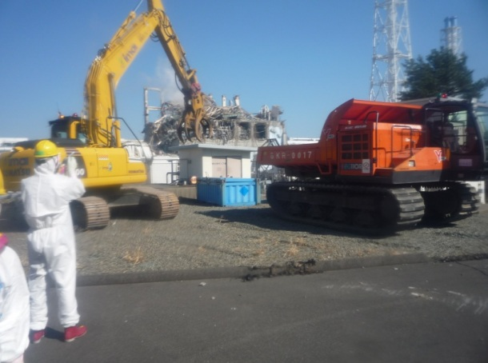
Case Studies – Nuclear Accident
Chernobyl-cleanning
Chernobyl-decontamination area
Fukushima-Remote-Controlled Rubble Cleaner at Fukushim-20

Slide 14
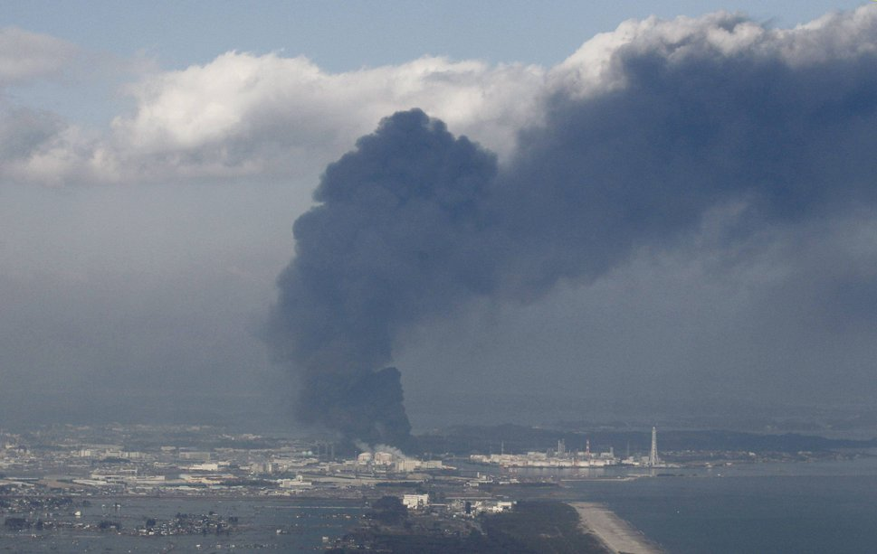
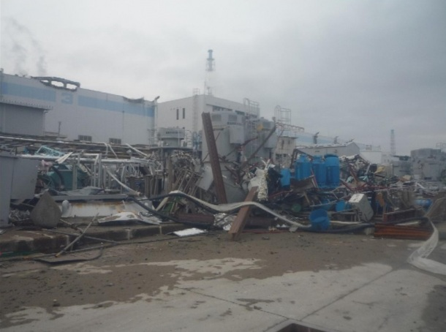
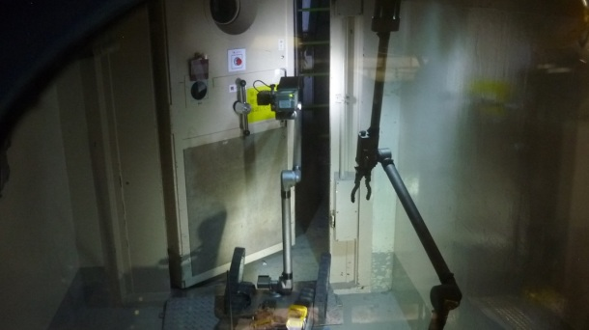
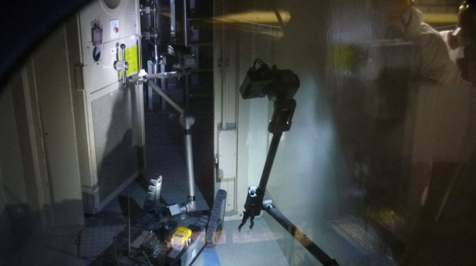
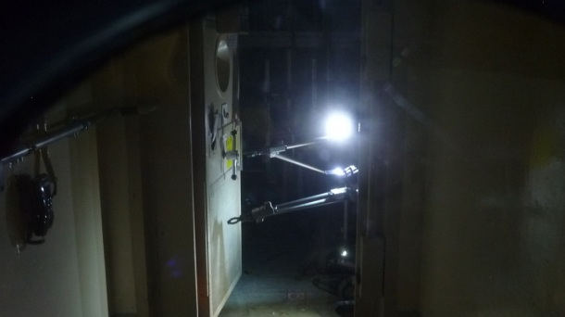
Fukushima-smoke after explosion
Fokushima-smoke after explosion
Fukushima-Damages at Fukushima Daiichi Nuclear Power Station-14
Fukushima Daiichi NPS-inside

Slide 15
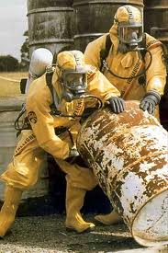
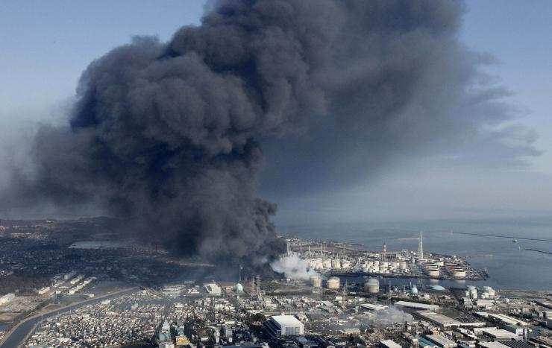
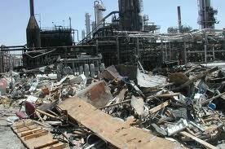
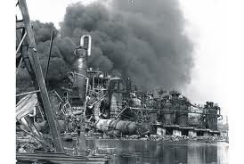
Case Studies – Technical Disaster

Slide 16
And?

Slide 17
Case Studies - UEMS
Number of Unplanned Explosions at the munitions sites (UEMS) by year and causalties, 2002 - 2011
Years | Total | Fatalitis | Injured
2002 | 20 | 1182 | 5787
2003 | 29 | 181 | 322
2004 | 20 | 1195 | 1683
2005 | 21 | 108 | 417
2006 | 21 | 54 | 174
2007 | 25 | 169 | 716
2008 | 25 | 55 | 340
2009 | 30 | 67 | 366
2010 | 31 | 148 | 277
2011 | 40 | 383 | 1944
Grand total | 262 | 3542 | 12026
Source: Small Arms survey

Slide 18
Case Studies - UEMS
  UEMS Risk index
HAZARD SEVERITY PROBABILITY |  | CATEGORY
 |  | Catastrophic | Major | Minor | Neglible
LEVEL | Likely | Extremely high | High | Medium | Low
 | Probable | High | Medium | Moderate | Low
 | Remote | Medium | Moderate | Low | Low
 | Improbable | Moderate | Low | Low | Extremely Low
 | Extremely improbable | Low | Low | Exrimely Low | Extremely Low

Slide 19
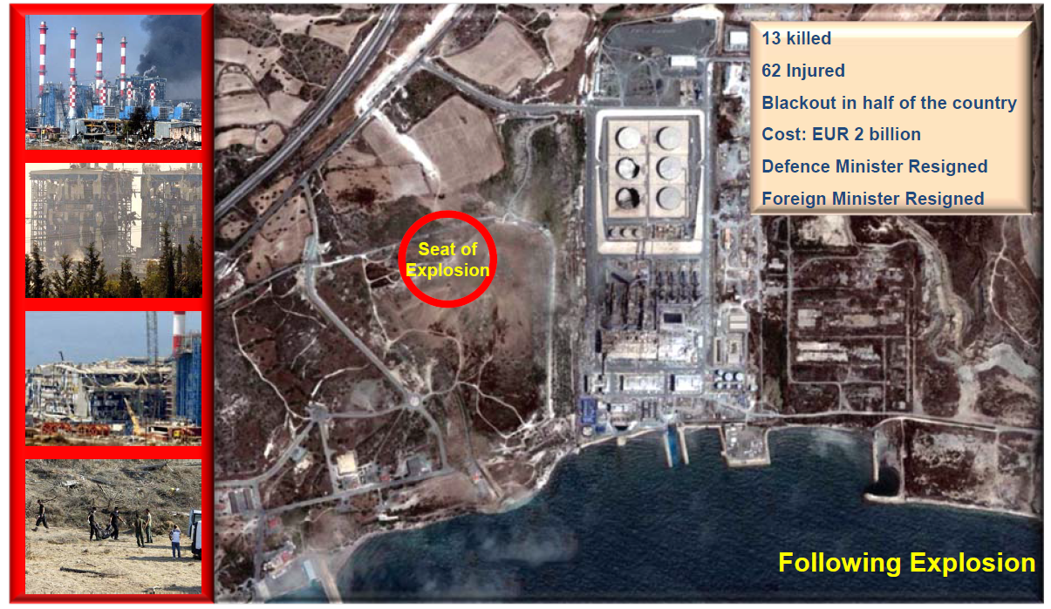
    Florakis Naval Base Cyprus
Containers stored near power plant
Crater and damaged power plant after UEMS
Containers stored near power plant
Crater and damaged power plant after UEMS

Slide 20
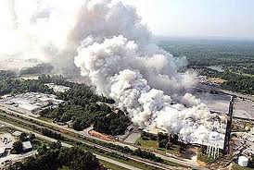
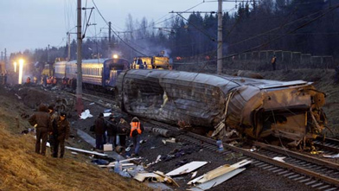
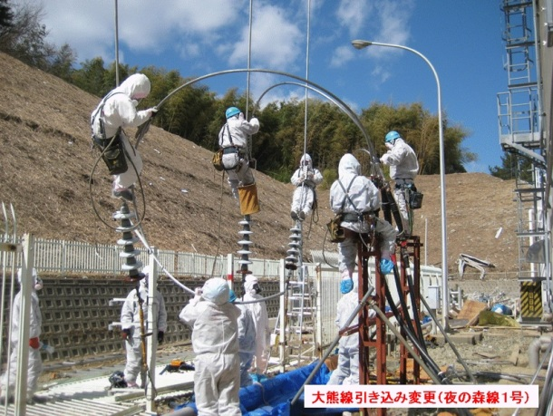
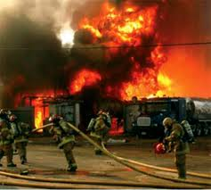
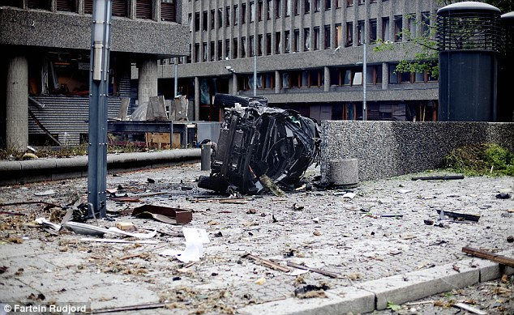
Case Studies – Terroris Actions
Terrorist and/or military attack on critical infrastructure installations important for defense strategy.

Slide 21
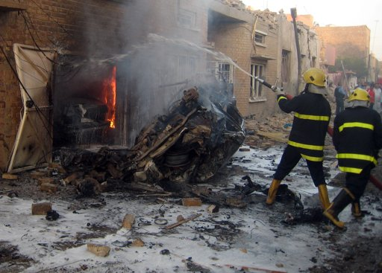
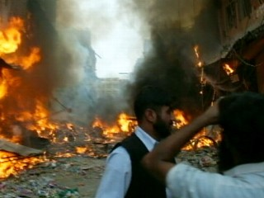
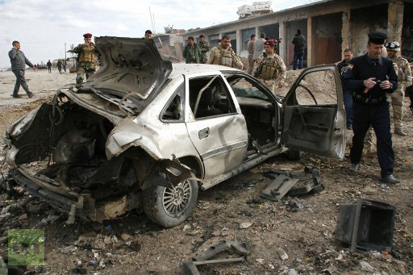
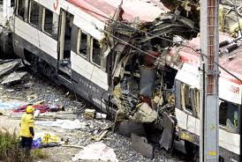
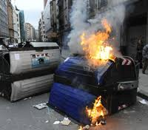
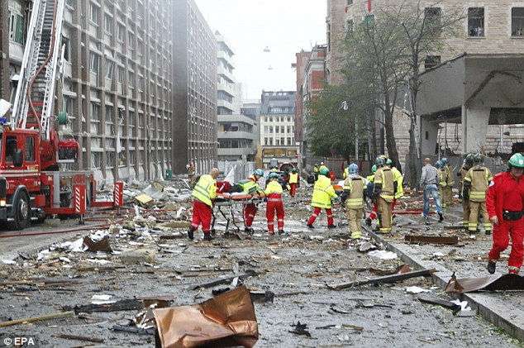
Case Studies – Terroris Actions
Terrorist attack as a method of warfare

Slide 22
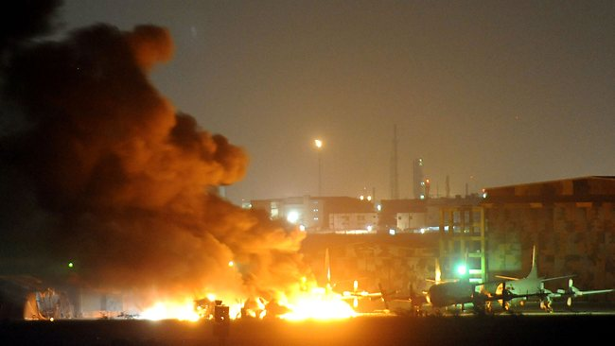
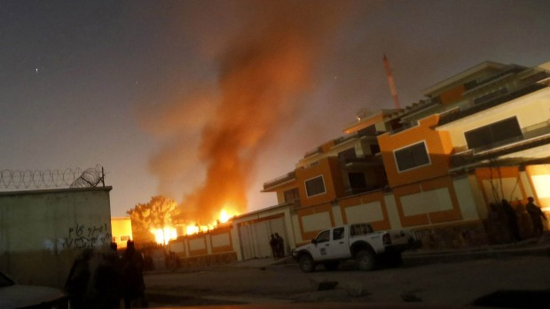
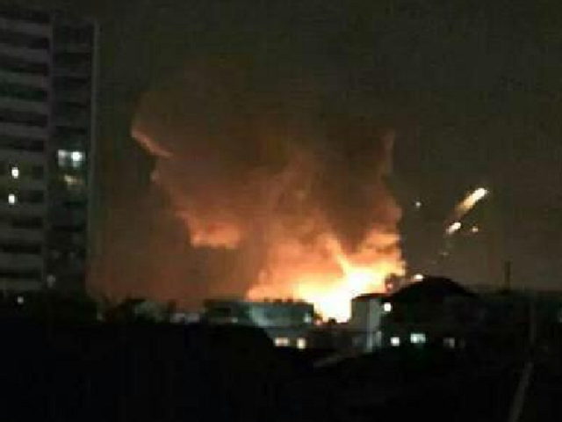
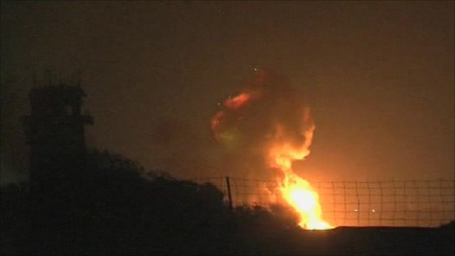
Case Studies – Attack on Military Base/Infrastructure
Islamist militants launched a brazen large-scale attack on a Pakistani naval base in the southern port city of Karachi.
An attack on a military base in Iraq

Slide 23
Under which Conditions are C-IED/EOD & CBRNe Accidents Today?

Slide 24
Extreme Hot Zone - Definition
Extreme hot zone
Could be described as a Zone under CBRNe incidents caused by natural or anthropogenic threats, or by military/terrorist attack on on chemical, petrochemical, pharmaceutical and other industries which use toxic industrial chemicals in the production processes, or hold them in stockpiles, as well as military and/or terrorist attacks on nuclear power plants, organic manufacturing and biological laboratories, military depots, plants and installations and technological accidents in these facilities and laboratories pose specific challenges for responders:
  secondary explosions of energy courses and chemicals,
  high temperature and opened fire,
  high concentrations of TIC and the other various gases by reducing the concentration of oxygen,
  a large radiology contamination with high intensity ionizing radiation creates zones and pockets within the zone where the first response units cannot even come to begin writing the evacuation and treatment of casualties and rehabilitation of the incident.
Z., Orehovec; Modern Doctrine of Using Robotic Systems Counter IED/EOD & CBRNe Threats; NCT CBRNe Asia 2013

Slide 25
Extreme Hot Zone - Definition
If there is no adequate response in real time, but is waiting for the intensity of the incident comes down to the level at which the first response units can access the area of the incident is lost precious time to help the victims and to decrease the quantity of emitted TIC in the surrounding area.
The challenge is to develop an integrated system of CBRNe response in the form of a multifunctional remotely removable and automated systems for extremely hot zone in which the first response teams cannot act that can be implemented preferably anywhere in the world, that will offer the following capabilities:
Z., Orehovec; Modern Doctrine of Using Robotic Systems Counter IED/EOD & CBRNe Threats; NCT CBRNe Asia 2013

Slide 26
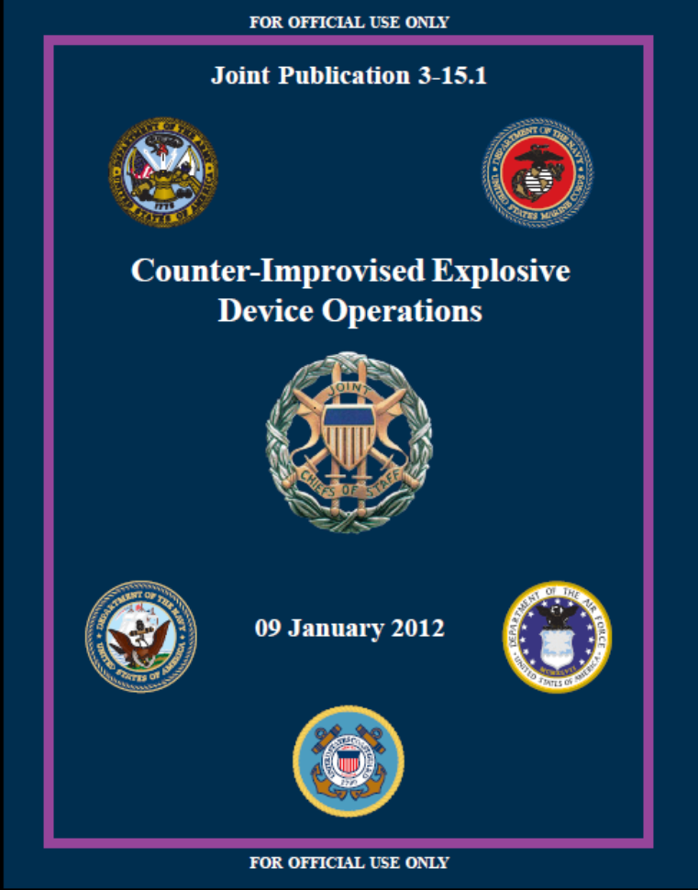

  NATO/USA Basic Doctrinal documents

Slide 27
Extreme Hot Zone - Definition
  Missions
The mission, which is set in the development of this concept
is not only
to protect the health and lives of employees of nuclear installations and teams engaged in the repair of an accident,
but to
develop a technology that will be able to perform tasks in accidental situations where, due to extreme conditions people in general cannot stay and thereby protect health and lives of people and animals outside the facility.
TASKS
    FIREFIGHTERS
    CIVIL DEFENCE
    POLICE
    MILITARY
Z., Orehovec; Modern Doctrine of Using Robotic Systems Counter IED/EOD & CBRNe Threats; NCT CBRNe Asia 2013

Slide 28
Extreme Hot Zone - Definition
  ... under limited conditions for operations such as:
wholesale destruction of infrastructure around the military instalations, chemical and nuclear facility (communications, water, electricity, access roads, etc.)
the deterioration of performance due to high local doses, radioactive, chemical contamination, fires, explosions, destruction of facilities on site
the feasibility of effective measures to manage incidents under conditions of external hazards (earthquake, flood)
unavailability of supply of electricity and other energy
potential cancellation of the instrumentation on locations
the impact of events in other plants on the site
Z., Orehovec; Modern Doctrine of Using Robotic Systems Counter IED/EOD & CBRNe Threats; NCT CBRNe Asia 2013

Slide 29
What remote controlled systems means?
Water and foam delivery
Manipulation
Spot decon
GPS
MET station
Decon patrons
Firefighting system
Radio
Foam and water
Self decon system
Sound
Camera system
Antiballistic steel structure
Self cooling system
CBRNe detection
Open Architecture
ATP 45 Compliant Data Collection & Distribution
Blade/Gripper
Road decontamination
Speed and mobility

Slide 30
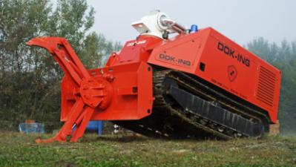
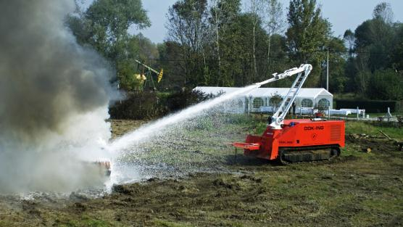
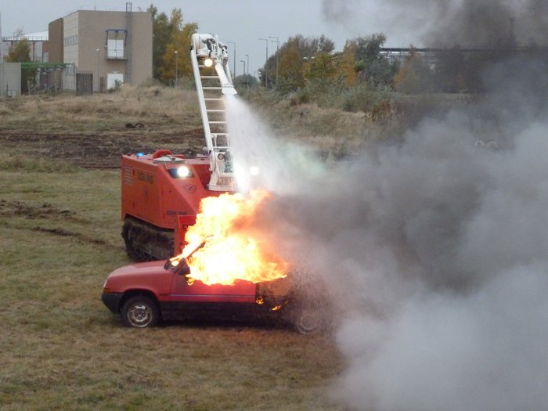
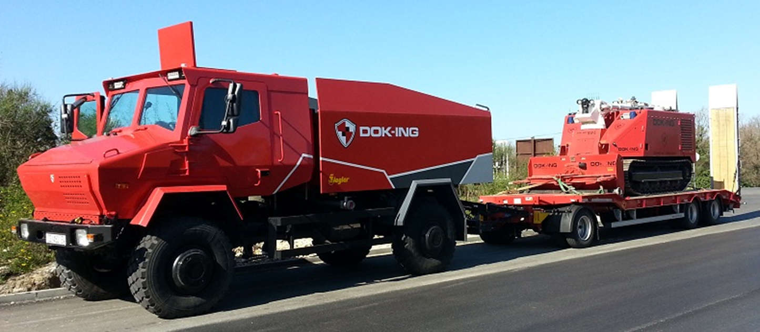
What remote controlled systems means?

Slide 31
  A number of CTAs related to emergency response exist, but do not focus on robotics
  A number of CTAs for futuristic robotic systems exists, but they do not focus on emergency response⃰
  The CTA identified how the introduction of robots into the CBRNE response will affect the responders’ workflow, decision making, and responsibilities.
  The CTA identified what information the robots must acquire; how that information may inform the response system activities; and how human responder roles may change with the introduction of robots.
  The CTA demonstrated the extensive human-centric nature of the current CBRNE response system and how little responders rely on intelligent systems or equipment; thus, incorporating robots will be a fundamental paradigm shift.
⃰CURTIS M. HUMPHREY and JULIE A. ADAMS, Department of Electrical Engineering and Computer Science Vanderbilt University, Nashville, TN 37235

Slide 32
The Information Flow Analysis (IFA)
IFA* provides an understanding of how the proposed robotic tasks may impact the CBRNE response by focusing on the information’s path through the system, both how it is used and transformed
  The identification of bottlenecks is critically important when developing robotic tasks in order to reduce responder workload.
  Teamwork is essential in a CBRNE response and the IFA highlights teamwork as a direct consequence of tying user levels to functions, which is especially useful when identifying how robot-enabled functions may be performed via teamwork.
  *Joint Publication 3-41; CBRN Consequence Management; 21 June 2012 // CURTIS M. HUMPHREY and JULIE A. ADAMS, Department of Electrical Engineering and Computer Science Vanderbilt University, Nashville, TN 37235

Slide 33
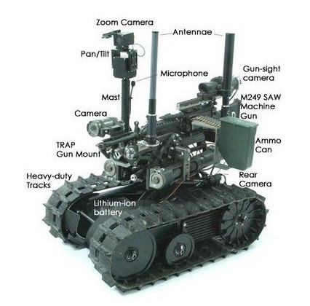
CBRNe Robotic tasks
Robots can significantly impact the Emergency Evaluation; Emergency Management; Incident/Hazard Mitigation; and Victim Care CBRNE Response activities by providing directed, specific, first-hand information prior to and during hot zone entry*
CTA identified tasks as requiring:
      detecting and locating hazards,
      identification of specific hazards,
      assessing the number and status of victims,
      surveying the scene, and
      monitoring the scene.
The IFA refined these elements into eight functions:
      Collection of Hazard Information,
      Collection of Epidemiological Information,
      Aerial Reconnaissance,
      Survey Operations,
      General Victim Search,
      Technical Victim Search,
      Hazard Identification, and
      Coordinate Field Operations.
  ⃰CURTIS M. HUMPHREY and JULIE A. ADAMS, Department of Electrical Engineering and Computer Science Vanderbilt University, Nashville, TN 37235

Slide 34
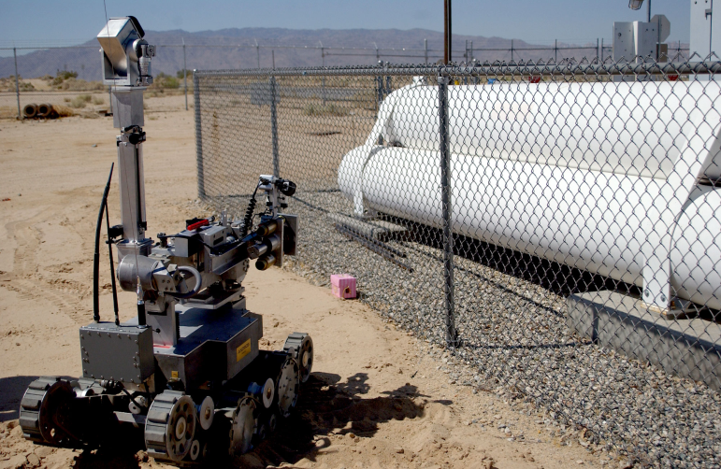
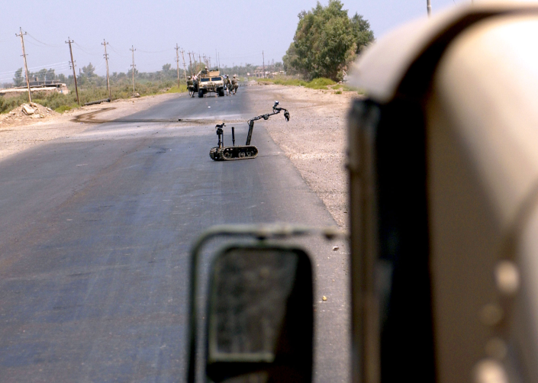
CBRNe Robotic tasks
Each function has different constraints or attributes, namely*:
      how quickly the robot must be deployed,
      the task execution speed,
      the robot’s field deployment duration,
      the robot’s sensor payload weight restrictions, and
      the frequency a task must be executed.
The five constraints informed the separation of the scene assessment task into three tasks:
      Survey,
      Identification, and
      Scene Observation
  *Joint Publication 3-41; CBRN Consequence Management; 21 June 2012 // CURTIS M. HUMPHREY and JULIE A. ADAMS, Department of Electrical Engineering and Computer Science Vanderbilt University, Nashville, TN 37235

Slide 35
CBRNE ROBOTIC TASKS - SURVEY TASK
The robotic Survey task encompasses six IFA functions:
      Collection of Hazard Information,
      Collection of Epidemiological Information,
      Aerial reconnaissance,
      Survey Operations,
      General Victim Search,and
      Technical Victim Search.
This task begins as soon as first responders arrive on scene*:
quickly deployable (i.e., less than 3 minutes)
Three functions Aerial Reconnaissance, Survey Operations, and General Victim Search must be executed expeditiously
The following sensors are required: location and video imagery, microphone, simple hazard detection (e.g. “Litmus style” testing), and
And number of optional sensors: heat based imagery, oxygen sensors, gas detection (i.e. a MulitRAE), temperature sensors, and radiation sensors
The following tasks are required: to allows professionals to clear a path in front of the vehicle so that others can pass safely remove dangerous objects, penetrate buildings, cut wires, and be used as the jaws-of-life, push up, atc.
  *Joint Publication 3-41; CBRN Consequence Management; 21 June 2012 // CURTIS M. HUMPHREY and JULIE A. ADAMS, Department of Electrical Engineering and Computer Science Vanderbilt University, Nashville, TN 37235

Slide 36
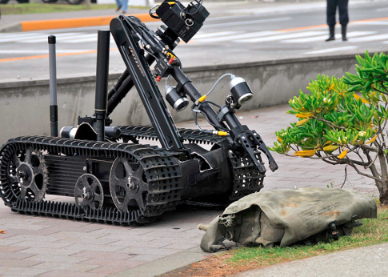
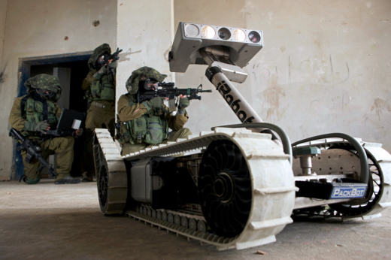
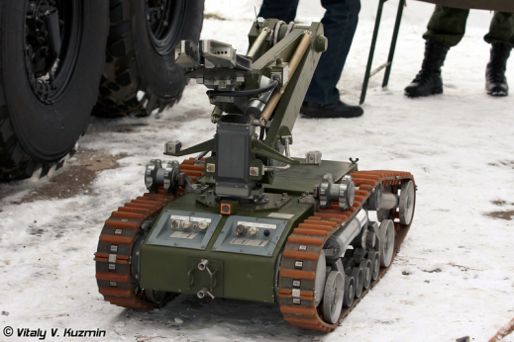
Identification task
The Survey task focuses on providing locations of potential hazards, victims, and other objects of interest, while the Identification task focuses solely on providing a detailed analysis of individual hazards*:
  divide the workload and increase the speed of analysis and reporting
  can act as a force multiplier and operate in conditions unsuitable for humans
  collection of physical hazard samples and placing them into sterilized containers
  Robot Decontamination is extremely important and must withstand decontamination
  must withstand long duration field deployments that last many hours and do not require human intervention
  Identification task robots require a minimum set of sensors to identify a wide range of hazards
  Identification task robots may have any number of effectors, but those that can provide the greatest benefit will open doors, grip objects, and gather hazard samples
  *Joint Publication 3-41; CBRN Consequence Management; 21 June 2012 // CURTIS M. HUMPHREY and JULIE A. ADAMS, Department of Electrical Engineering and Computer Science Vanderbilt University, Nashville, TN 37235

Slide 37


Scene observation/object tracking task
The Scene Observation/Object Tracking task encompasses the core IFA function Coordinate Field Operations, which has two attributes that differ from the other scene assessment functions*:
    very long duration deployments (i.e. many hours) and
    continuous task executions (i.e. always actively performing the task).
  *Joint Publication 3-41; CBRN Consequence Management; 21 June 2012 // CURTIS M. HUMPHREY and JULIE A. ADAMS, Department of Electrical Engineering and Computer Science Vanderbilt University, Nashville, TN 37235

Slide 38


Medical initial assestment task
The CTA and IFA identified a two-step medical assessment that assesses the number of victims,including gross triage (i.e., two-level basic triage) followed by a complete triage on individual victims*:
  The first step must be performed quickly, at the very beginning of the incident, and the information is primarily used by command management.
  The second step is performed later and the information is primarily used by medical personnel (e.g. EMS, hospitals)
  This task requires sensors to gather imagery, sound (i.e. microphone), location, temperature and oxygen sensors
  Potential robot effectors will allow the robot or a human responder to speak to a victim, display video to provide additional comfort, and dispense fluids (e.g. water).
  *Joint Publication 3-41; CBRN Consequence Management; 21 June 2012 // CURTIS M. HUMPHREY and JULIE A. ADAMS, Department of Electrical Engineering and Computer Science Vanderbilt University, Nashville, TN 37235

Slide 39



Medical victim transportation task
A platform on which non-ambulatory victims can be transported to safety. This task was identified by the CTA and IFA as a sub-task of the Victim Care*:
  Must be able to evacuate victims and function safely (i.e., non-traumatically) around victims. This task requires medium duration field deployments (i.e. approximately an hour) since evacuations may require many minutes.
  This task requires sensors for tracking victims, self-location, and detecting sound (i.e., microphone)
  Future optional sensors may include medical monitoring sensors, such as heart rate, blood pressure, etc.
  These robots may have effectors that secure victims during transport and provide communications between the victim and medical personnel.
  *Joint Publication 3-41; CBRN Consequence Management; 21 June 2012 // CURTIS M. HUMPHREY and JULIE A. ADAMS, Department of Electrical Engineering and Computer Science Vanderbilt University, Nashville, TN 37235

Slide 40



Decontamination task
This task encompasses three functions identified by the CTA and IFA*:
  On-site Gross and Technical Decontamination and Decontamination Facility Setup
  Robots for this task must permit autonomous deployment, the ability to setup decontamination equipment, and the ability to perform automated decontamination
  The robots require sensors that can quantify the decontamination quality while identifying responders and tracking victims who have been decontaminated.
  *Joint Publication 3-41; CBRN Consequence Management; 21 June 2012 // CURTIS M. HUMPHREY and JULIE A. ADAMS, Department of Electrical Engineering and Computer Science Vanderbilt University, Nashville, TN 37235

Slide 41

CBRN Hazard disposal task
The Hazard Disposal task requires robots to remove, contain, or mitigate small hazards. These robots need to complete this dangerous task with minimal risk of failure*:
  Robots performing this task must be decontaminated in order to permit robot reusability.
  The robots must accommodate different manipulators and manipulator configurations in order to handle a large variety of hazards.
  The robots performing this task require imagery that allows responders to view the environment, the device, and how the robot is interacting with the hazard.
  Location information is also required to allow the robot to navigate to the hazard location.
  Robots supporting this task may benefit from many optional sensors depending on the hazard, such as sound (i.e. microphone), temperature, and heat-based imagery.
  *Joint Publication 3-41; CBRN Consequence Management; 21 June 2012 // CURTIS M. HUMPHREY and JULIE A. ADAMS, Department of Electrical Engineering and Computer Science Vanderbilt University, Nashville, TN 37235

Slide 42


Resource hauling task
The robotic Resource Hauling task transports resources to other teams during the response. Resource Hauling robots require*:
  location sensors for navigating between locations
  sensors for object following that permit robots to effectively follow responders when transporting their equipment.
  need to keep pace with mobile responders in order to not irritate the responders and slow their task completions
  must provide the same or better protection against equipment damage.
  can withstand long deployments (i.e. many hours).
This robot is most likely a ground robot, since they can accommodate the weight of the equipment and endure long deployments.
  *Joint Publication 3-41; CBRN Consequence Management; 21 June 2012 // CURTIS M. HUMPHREY and JULIE A. ADAMS, Department of Electrical Engineering and Computer Science Vanderbilt University, Nashville, TN 37235

Slide 43



ROBOTIC TASKS*
IEDs are
a dangerous and effective weapon system that military forces face
can be almost anything with any type of material and initiator
an improvised device that are designed to cause death or injury by using explosives alone or in combination with other materials, to include projectiles, toxic chemicals, biological toxins, or radiological material
can be produced in varying sizes and can have different types of containers and functioning and delivery methods
can use commercial or military explosives, homemade explosives, or military ordnance and ordnance components...
*Counter Improvised Explosive Devices Strategic Plan 2012 - 2016; JIEDDO

Slide 44



Counter-Improvised Explosive Device Operations
Consists of activities to detect and neutralize IEDs before they detonate or mitigate the effects of the detonation at the point of attack to ensure freedom of movement and safer operations.
These activities are enabled by rapid identification, development, acquisition, and delivery of capabilities for route clearing, device and explosive detection, improved EOD robots, and better vehicle and personnel protections
*Counter Improvised Explosive Devices Strategic Plan 2012 - 2016; JIEDDO

Slide 45
ROBOTIC TASKS
Robots and sensors have to be capable of performing in one or more of the four challenge categories:
  endurance,
  reconnaissance,
  detect and disrupt
  The endurance challenge measures speed and endurance of mounted and dismounted support robots over unimproved road (must be able to keep up and keep going, just as the soldiers on patrol where IEDS are present must do
  The reconnaissance challenge measures sensor acuity, platform mobility and spatial accuracy required to locate objects in a tactical environment. (This challenge is important in continuing to improve and drive or shape enablers for lightweight robots in support of dismounts)
  The detect challenge involves locating IED triggers in a tactical environment without activating them to see which sensors and technologies can be adopted to platforms supporting dismounted operations
*Counter Improvised Explosive Devices Strategic Plan 2012 - 2016; JIEDDO

Slide 46









C-IED/EOD & CBRNe ROBOTS TODAY
LIGHT

Slide 47




C-IED/EOD & CBRNe ROBOTS TODAY
MEDIUM

Slide 48











C-IED/EOD & CBRNe ROBOTS TODAY
HEAVY

Slide 49





C-IED/EOD & CBRNe ROBOTS TODAY
HEAVY

Slide 50
C-IED/EOD & CBRNe ROBOTS TODAY
HEAVY
Water and foam delivery
Manipulation
Spot decon
GPS
MET station
Decon patrons
Firefighting system
Radio
Foam and water
Self decon system
Sound
Camera system
Antiballistic steel structure
Self cooling system
CBRNe detection
Open Architecture
ATP 45 Compliant Data Collection & Distribution
Blade/Gripper
Road decontamination
Speed and mobility

Slide 51

Remotely!
LoS 1500m

Slide 52


Eyes, ears and muscles
Gripper
  Lift, Breach, Twist, Open, Push
Tracks
  Obstacles, Sand, Mud, Mountains,
  Forrest, Fires
Heat resistance
  Sprinkler, Heat shield
Fire fighting system
  Foam, water

Slide 53






Slide 54


Options & configurations
  Effectors
  Disruptor
Sensors
Oxygen level
Explosive gases sensor
Temperature
Monitoring
Audio
Video
GPS
MET Station
  Detectors
  Radiological
  Chemical
  Tactical command and control
  Information collection
  Data delivery
  Emergency preparedness enhancement

Slide 55

Control station for CBRN monitoring In combination with tactical command and control

Slide 56


MVF-5 Tracked heavy duty multifunctional system for crisis management - tactical command and control centre on logistic truck

Slide 57

MVF-5 Tracked heavy duty multifunctional system for emergency response - tactical command and control centre on logistic truck
Tactical command and control centre
Multifuctional robotic system
Logistic truck with addtional resources
Logistic trailer
System has been developed for emergency preparedness, reconnaissance and information collection, monitoring and data delivery, firefighting in high danger areas, object/obstacle removal on the path of intervention, decontamination, removal and collection of objects and water supply in critical conditions.

Slide 58
THANK YOU

